Slide 1
Agenda
Angular Routing
Router
Router outlet
Wildcard Route
How Routing works
example on Routing, Child Route, Wildcard Route, Default Route, redirectTo, routerLink, routerLinkActive etc.

Slide 2
Angular Routing
Routing is mechanism used by angular for navigating between page and displaying appropriated component/page on browser.
Angular routing helps navigation across the application from one view to another view.
It also allows us to maintain the state, implement modules, and load the modules based on the role of the user.

Slide 3
Router
Angular Router allows us to:
redirect a URL to another URL
resolve data before a page is displayed
run scripts when a page is activated or deactivated
lazy load parts of our application.

Slide 4
Router Outlet
Router-outlet in Angular works as a placeholder which is used to load the different components dynamically based on the activated component or current route state.
Navigation can be done using router-outlet directive and the activated component will take place inside the router-outlet to load its content.
To enable routing, we need to use router-outlet into our HTML template like this.
Syntax: <router-outlet></router-outlet>

Slide 5
WildCard Route
Wildcard route to intercept invalid URLs and handle them gracefully.
A wildcard route has a path consisting of two asterisks (* *).
It matches every URL, the router will select this route if it can't match a route earlier in the configuration. A wildcard route can navigate to a custom "404 Not Found" component or redirect to an existing route.
{ path: '**', component: PageNotFoundComponent }
If the entire router configuration is processed and there is no match, router navigation fails and an error is logged.
Note: If you add a wildcard route as the first route, no other routes would be reached and the wildcard route would always be matched. As a result, you should always add a wildcard route as the last route in your router configuration.

Slide 6
How Angular Router Works
Every time a link is clicked or the browser URL changes, Angular router makes sure your application reacts accordingly. To accomplish that, Angular router performs the following 7 steps in order:
Step 1 - Parse the URL:
In step 1 of the routing process, Angular router takes the browser URL and parses it as a URL tree.
For the URL https://example.com/about/skill, the corresponding URL tree would look like this:
- (root)
- about
- skill

Slide 7
Step 1
To parse the URL, Angular uses the following conventions:
/ - slashes divide URL segments
() - parentheses specify secondary routes
: - a colon specifies a named router outlet
? - a question mark separates the query string parameters
// - a double slash separates multiple secondary routes

Slide 8
/ - Slashes Divide URL Segments:
In Angular routing, the forward slash (/) is used to divide different segments of the URL into distinct parts, each representing a specific route or resource.
Example: Consider the URL https://example.com/products/laptops. Here, /products/laptops is divided into two segments: products and laptops, representing different parts of the application's routing structure.

Slide 9
() - Parentheses Specify Secondary Routes:
Parentheses are used to specify secondary routes or named outlets in Angular routing.
Example: Suppose you have a primary route for displaying a product list and a secondary route for displaying individual product details. The URL https://example.com/products/(list//details) would represent navigating to the product list component in the primary outlet and the product details component in a secondary outlet named details.

Slide 10
: - Colon Specifies a Named Router Outlet:
A colon is used to define route parameters in Angular routing. It specifies a named router outlet where dynamic values can be passed.
Example: Consider the URL https://example.com/products/:id. Here, :id represents a route parameter named id. When navigating to this URL with a specific product ID, Angular captures the ID value and passes it to the corresponding component.

Slide 11
? - Question Mark Separates Query String Parameters:
The question mark (?) is used to separate query string parameters in the URL. Query parameters are used to pass additional data to the application.
Example: In the URL https://example.com/search?q=laptop&page=1, ?q=laptop&page=1 represents the query string parameters. Here, q and page are query parameters, and their values (laptop and 1) are passed to the application for processing.

Slide 12
// - Double Slash Separates Multiple Secondary Routes:
If a route has multiple secondary outlets, they can be separated by a double slash (//) in Angular routing.
Example: Suppose you have a primary route for displaying a product list, and you want to display both product details and reviews simultaneously in separate outlets. The URL https://example.com/products/(list//details//reviews) would represent navigating to the product list component in the primary outlet and the product details and reviews components in separate secondary outlets.

Slide 13
Step 2 – Redirect
Before Angular router uses the URL tree to create a router state, it checks to see if any redirects should be applied.
Only one redirect is applied!
const routes: Routes = [
{ path: '', redirectTo: '/login', pathMatch: 'full' }, // Redirect from root to login
{ path: 'login', component: LoginComponent },
{ path: 'dashboard', component: DashboardComponent },
{ path: 'products', component: ProductsComponent }
];

Slide 14
Step 3 - Identify the router state
Angular router traverses the URL tree and matches the URL segments against the paths configured in the router configuration.
If a URL segment matches the path of a route, the route's child routes are matched against the
remaining URL segments until all URL segments are matched.
If no complete match is found, the router backtracks to find a match in the next sibling route

Slide 15
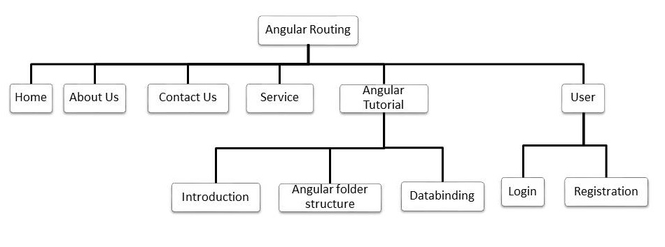

Slide 16
Step 4 - Guard - run guards
• At the moment, any user can navigate anywhere in the application anytime. That's not always the right thing to do.
•Perhaps the user is not authorized to navigate to the target component.
• Maybe the user must login (authenticate) first.
• Maybe you should fetch some data before you display the target component.
• You might want to save pending changes before leaving a component.
• You might ask the user if it's OK to discard pending changes rather than save them.
• You can add guards to the route configuration to handle these scenarios.

Slide 18
How Angular Router Works
Step 5 - Resolve - run resolvers
it resolves the required data for the router state. Resolvers are services that fetch necessary data before the route is activated.
Example: Consider a scenario where you have a route /products/:id to display product details. Before activating this route, you need to fetch the product details from an API. You can use a resolver to fetch the product data before activating the route.
Step 6- Activate
it activates the Angular components to display the page.
Step 7 – Manage
Finally, when the new router state has been displayed to the screen, Angular router listens for URL changes and state changes.
it manages navigation and repeats the process when a new URL is requested.

